Slide 1

Data Structure Visualization
Data Structure implementation using java

Slide 2
- Neil Armstrong

Slide 3
Your best quote that reflects your approach… “It’s one small step for man, one giant leap for mankind.”
- Neil Armstrong

Slide 4
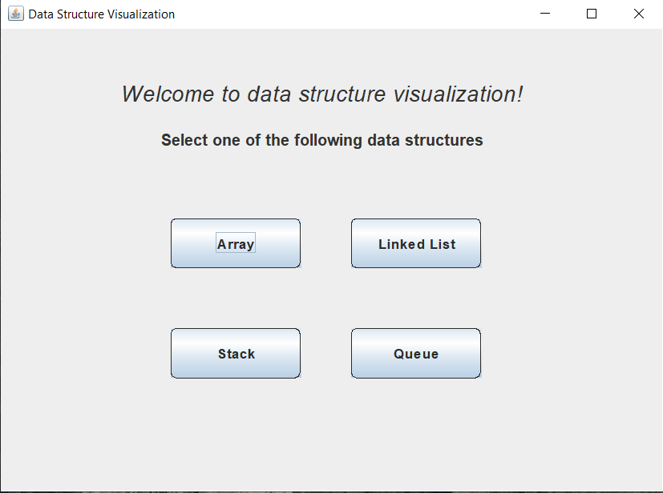
Project entry window
When the user runs the program, the start window of the program appears.
Here, the user is capable of selecting different data structures and some with different implementations to help selecting “best” data structure.
The user can enter either strings or integers in his/her selected data structure and they are informed when something goes wrong.
We need to mention that if the user wants to perform the removal operation, they must do the removal before adding any new item.

Slide 5
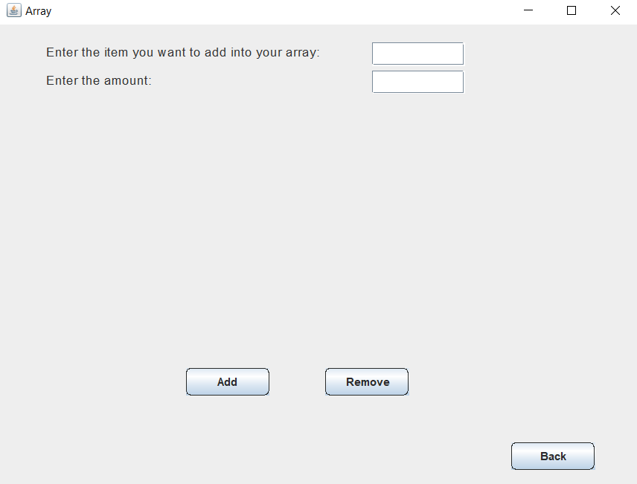
Array Data Structure
If the user selects the array data structure, a window will appear where the user could do some operations on that data structure.
If the user is to choose to add an item, he/she needs to enter that item in the first text field, and how many times this item will be repeated in the array in the second text filed.
// aktb el performance

Slide 6
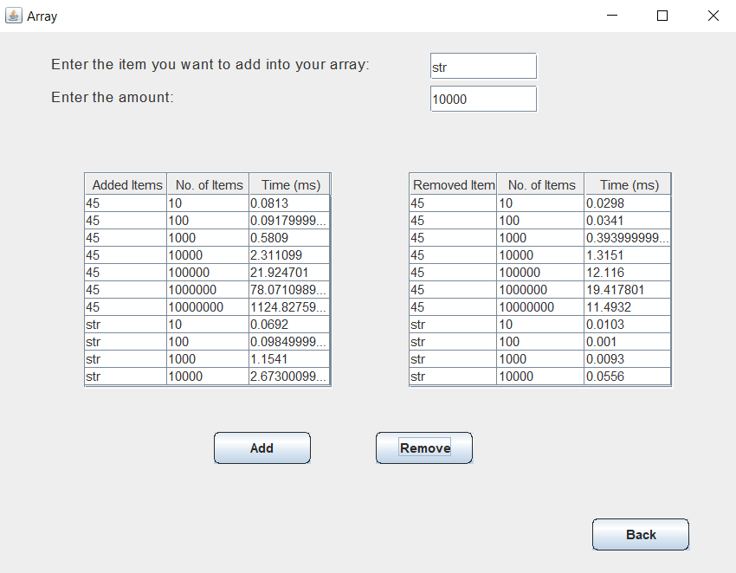
Array Data Structure (Cont’d)
If, for example, the user enters the number 45 and to be added these many times as shown in the figure, he/she will be able to see that item with the entered amount are added, and the time taken to perform each insertion operation.
We need to mention that the insertion operations happen in the last place available in the array. And the removal operations happen in the last, actually filled position in the array.

Slide 7
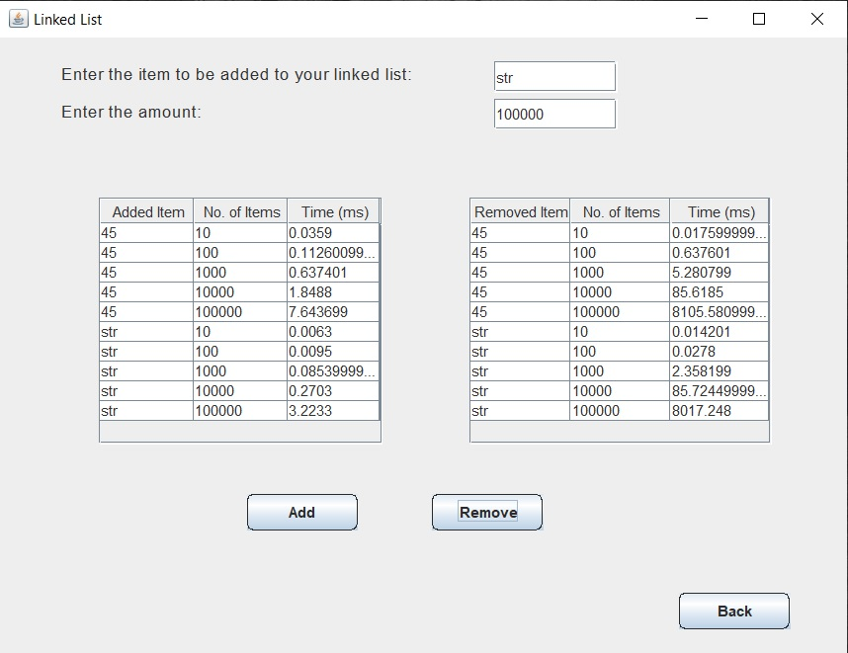
Linked List Data Structure
If the user has chosen the linked list data structure for his exploration, he would also nearly the same window as in the array structure.

